Slide 1

LOAN STATUS PREDICTION
Submitted by:
Romel Jude Melville (STB03003)
Data Science Trainee: Batch 1
Under Esteemed Guidance of:
Ms. Urooj Khan

Slide 2
INTRODUCTION
Loans are the core business of banks. The main profit comes from the loan’s interest.
The loan company grants a loan after an intensive process of verification and validation.
However, the still don’t have assurance if the applicant is able to repay the loan with no difficulties.
In this project, I have built a predictive model to predict if an applicant is able to repay the lending amount to the company or not.
I prepared the data using Jupyter notebook and have used variable models to get the best fit model.

Slide 3
PROJECT OVERVIEW
To improve accuracy in predicting loan outcomes
Significance of this analysis is crucial for better decision-making in finance
Used data analysis and machine learning techniques
The goal is to empower financial institutions with reliable decision-making.

Slide 4
PROBLEM DEFINITION
Before giving loan to the customer, the bank decides whether the customer would be able to repay it or not based on his financial history, credit score, income stability, employment status, and other relevant factors
To build a model to predict whether the customer will be able to repay the loan or not

Slide 5
DATASET
Loan_ID: Unique loan id
Gender: Male or Female
Married: Applicant Married (Y/N)
Dependents: Number of dependents
Education: Applicant Education (Graduate / Under Graduate)
Self_Employed: Self Employed (Y/N)
ApplicantIncome: Applicant income

Slide 6
DATASET contd….
CoapplicantIncome: Coapplicant income
LoanAmount: Loan amount in thousands of dollars
Loan_Amount_Term: Term of loan in months
Credit_History: Whether credit history meets guidelines yes or no
Property_Area: Urban / Semi Urban/ Rural
Loan_Status: Whether loan approved (Y/N) Target variable

Slide 7
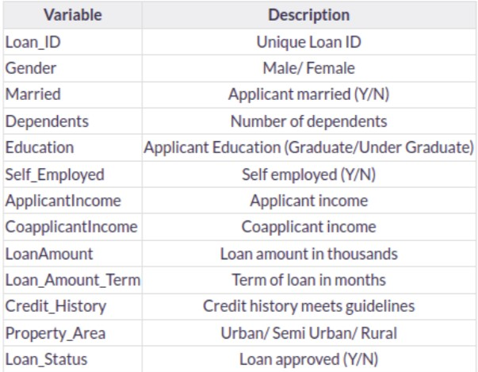
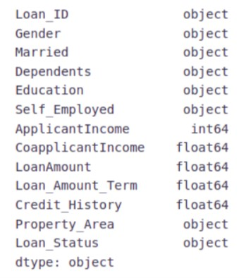
DATASET contd….

Slide 8
FEATURE SCALING
Feature scaling is essential for ensuring that various input features, such as income and loan amount, are on a comparable scale
Standardizing or normalizing the features through scaling helps prevent disparities in magnitudes from skewing the predictive model.
By applying feature scaling to ensure uniformity in scale, the loan status prediction model can capture better relationships between features, resulting in a more accurate and reliable outcome

Slide 9
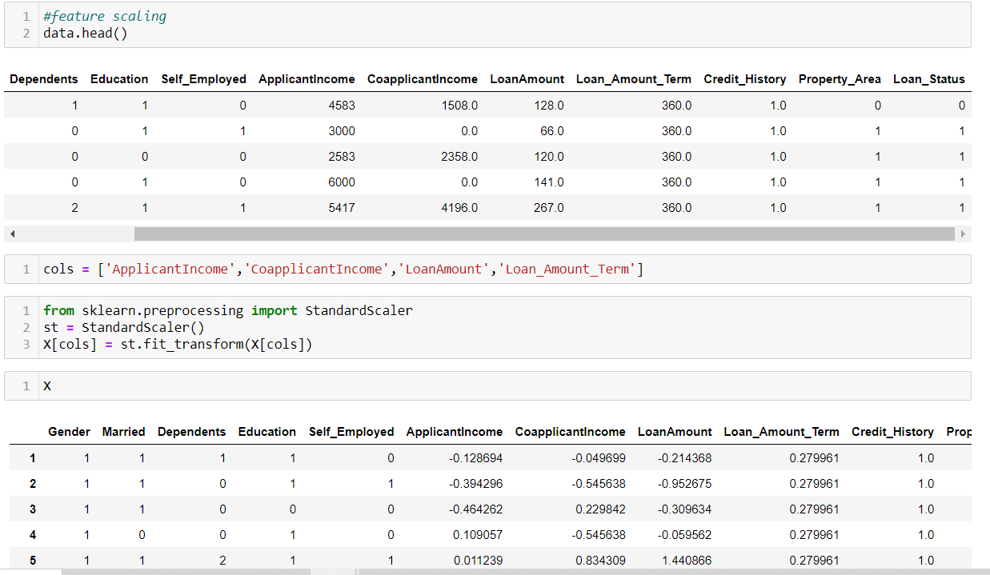
FEATURE SCALING contd….

Slide 10
TRAIN TEST SPLIT
Divide the dataset into two subsets – a larger training set used to train the machine learning model and a smaller testing set used to assess its performance on new, unseen loan applications.
Allocate 80% of the data for training and reserve 20% for testing

Slide 11
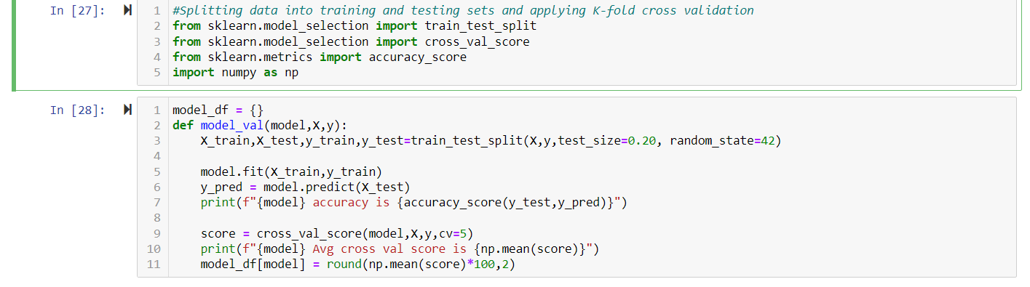
K-FOLD CROSS VALIDATION
It is a technique for evaluating predictive models
It involves dividing the dataset into ‘k’ folds, training the model ‘k’ times, and evaluating its performance on different subsets of the data

Slide 12
MODEL SELECTION
Logistic Regression: Logistic Regression is suitable for binary classification tasks, making it relevant for predicting loan approval (1) or denial (0).
Support Vector Classifier (SVC): SVC is effective for binary and multiclass classification, making it versatile for predicting loan approval or denial. Sensitive to noise, and model performance may be impacted by outliers.
Decision Tree: Decision trees are adept at capturing complex relationships in data, suitable for scenarios where loan approval depends on multiple factors.

Slide 13
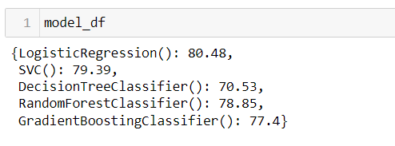
MODEL SELECTION contd….
Random Forest Classifier: Effective for classification tasks, including loan status prediction, by aggregating predictions from multiple trees.
Gradient Boosting Classifier: Well-suited for classification tasks, including loan status prediction by combining the strengths of multiple weak learners.
The below image shows the accuracy scores before hyperparameter tuning

Slide 14
HYPERPARAMETER TUNING
Hyperparameter tuning involves optimizing configuration settings for machine learning models before training
Techniques such as Grid Search or Random Search are employed to systematically explore various combinations of hyperparameter values.
The selection of appropriate evaluation metrics, such as accuracy or precision, is crucial in guiding the tuning process.
Hyperparameter tuning is an iterative process, refining the search based on initial results.

Slide 15
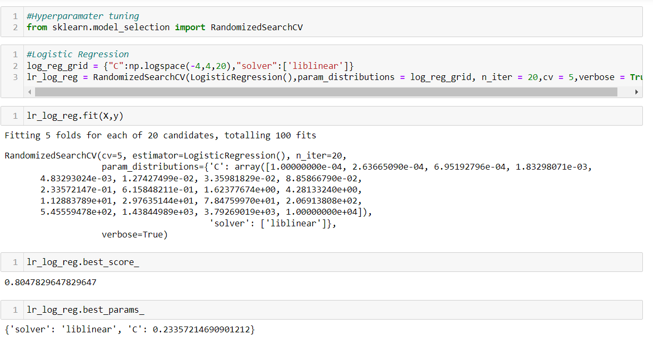
HYPERPARAMETER TUNING contd….

Slide 16
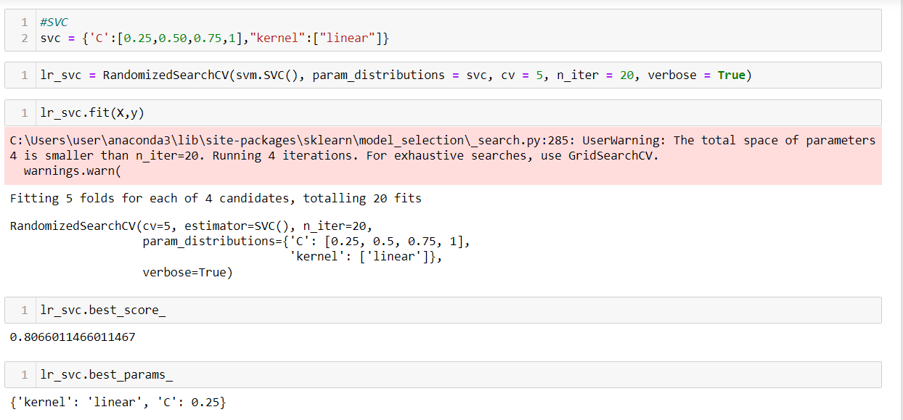
HYPERPARAMETER TUNING contd….

Slide 17
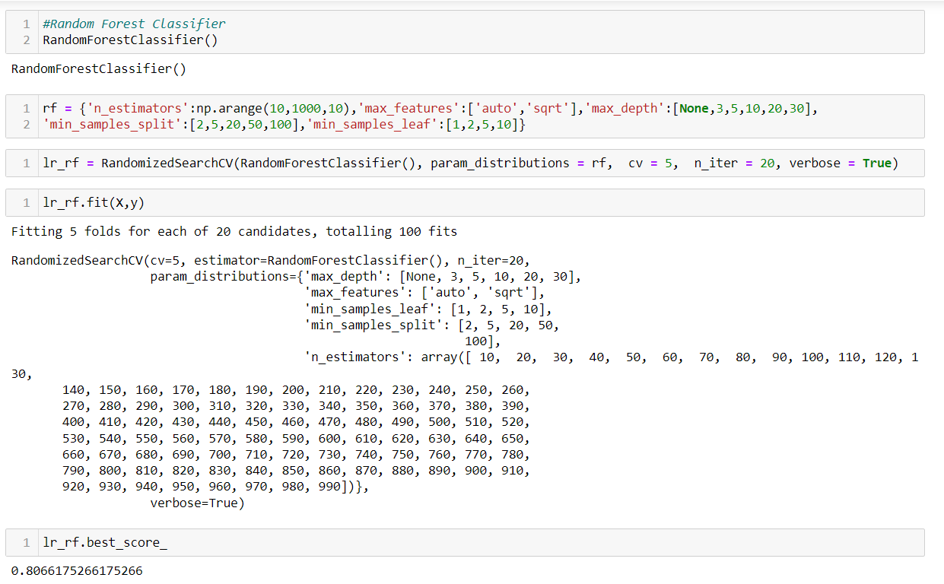
HYPERPARAMETER TUNING contd….

Slide 18
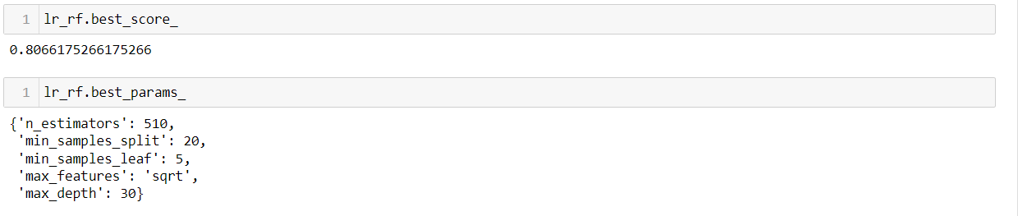
HYPERPARAMETER TUNING contd….

Slide 19
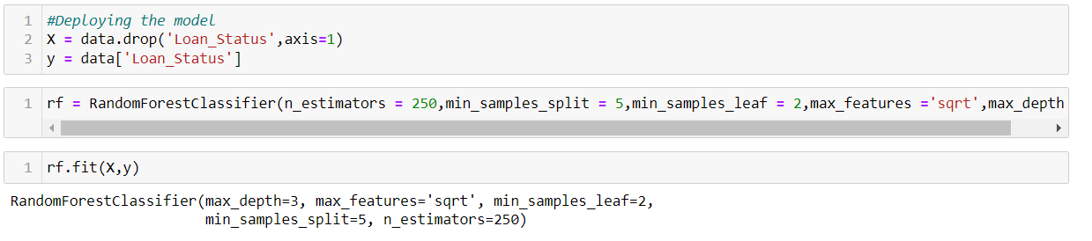
OUTPUT

Slide 20
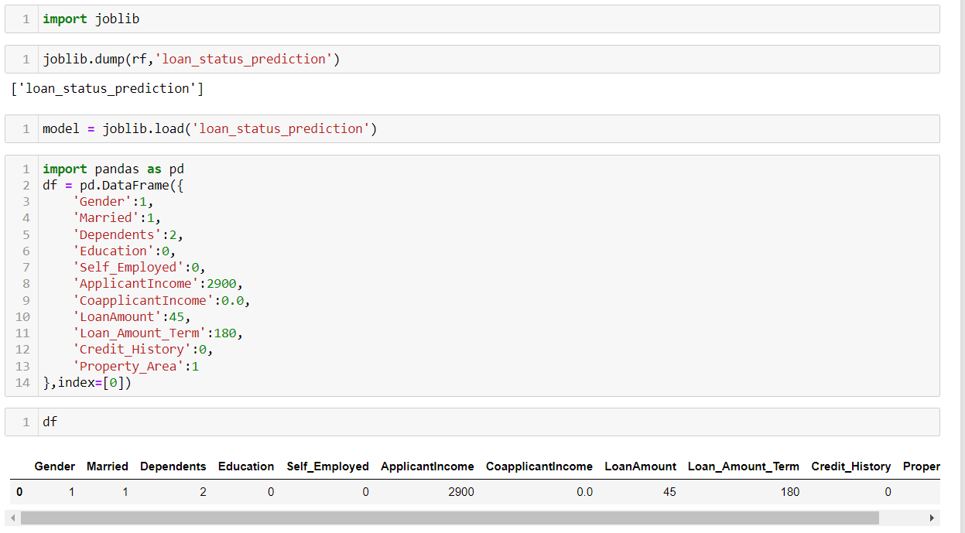
OUTPUT

Slide 21
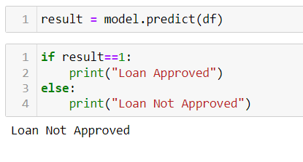
OUTPUT

Slide 22
CONCLUSION
Here, it can be concluded with confidence that the Random Forest Classifier model is extremely efficient and gives a better result when compared to other models
It works correctly and fulfills all requirements of bankers
This system properly and accurately calculates the result
It predicts the approval or rejection of loan to loan applicant or customer very accurately

Slide 23
REFERENCES
https://www.geeksforgeeks.org/loan-approval-prediction-using-machine-learning/
https://www.analyticsvidhya.com/blog/2022/02/loan-approval-prediction-machine-learning/
https://www.scribd.com/document/428570971/4-18-21

Slide 24
THANK YOU

